Slide 1
Monopoly & Monopolistic Competition
Profit Maximization for Price Searchers
Management 405
Prof. Paola Giuliano · UCLA Anderson

Slide 2
Monopoly & Monopolistic Competition · Announcements
Announcements
Problem set 3
  Due November 7
Problem set 4
  Posted on BruinLearn
Management 405 · Monopoly and Monopolistic Competition
2

Slide 3
Monopoly & Monopolistic Competition · Roadmap
Outline
1
Profit maximization for price searchers
Set MR = MC; markup and the Lerner index
2
Monopoly and welfare impact
How monopoly restricts output and reduces welfare
3
Government and market power
Antitrust, regulation, and market definition
4
Monopolistic competition
Free entry drives long-run profit to zero
Management 405 · Monopoly and Monopolistic Competition
3

Slide 4
Monopoly & Monopolistic Competition · Market Structures
The Four Basic Market Structures
 | Perfect Competition | Monopolistic Competition | Oligopoly | Monopoly
Number of firms | Many | Many | Few | One
Type of products sold | Identical | Differentiated | Identical or Differentiated | Unique
Barriers to entry | None | None | Some | Many
Management 405 · Monopoly and Monopolistic Competition
4

Slide 5
Monopoly & Monopolistic Competition · Roadmap
Outline
1
Profit maximization for price searchers
Set MR = MC; markup and the Lerner index
2
Monopoly and welfare impact
How monopoly restricts output and reduces welfare
3
Government and market power
Antitrust, regulation, and market definition
4
Monopolistic competition
Free entry drives long-run profit to zero
Management 405 · Monopoly and Monopolistic Competition
5

Slide 6
Monopoly & Monopolistic Competition · Firm Demand
Firm Demand: Price Takers vs. Price Searchers
Price taker
Price searcher
Price
Price
d = P* = MR
P*
MR
d
Output
Output
Management 405 · Monopoly and Monopolistic Competition
6

Slide 7
Monopoly & Monopolistic Competition · Market Power
The Meaning of Market Power
Nearly all firms compete somewhat
  All products face substitutes, no matter how imperfect
  Even if you are the only player, you must worry about potential entry
The real distinction is between:
  Price searchers
  Price takers
The real test of market power: “Do I face a downward-sloping demand curve?”
Management 405 · Monopoly and Monopolistic Competition
7
Notes:
What would you do if your water utility charged $1,000 per gallon? – check Melanie
Former CEO of Microsoft, link: https://www.youtube.com/watch?v=Vhh_GeBPOhs&list=RDVhh_GeBPOhs
In the extreme case of a monopoly, the firm’s demand curve is the market demand curve

Slide 8
Monopoly & Monopolistic Competition · Profit Maximization
Profit Maximization for a Price Searcher
P
MR = MC
300
Firm's demand
Q = 1,600 − 4P
MC = 200
d
Teaching Note MR = MC
MR
Q* = 400
Q
Management 405 · Monopoly and Monopolistic Competition
8

Slide 9
Monopoly & Monopolistic Competition · Profit Maximization
MR = MC: A Worked Example
1
Demand and inverse demand
Q = 1600 − 4P
P = 400 − ¼Q
2
Total and marginal revenue
TR = 400Q − ¼Q²
MR = ΔTR/ΔQ = 400 − ½Q
3
Set MR = MC (MC = 200)
400 − ½Q = 200 ⇒ Q* = 400
Optimal quantity & price
Q* = 400, P* = 300
Management 405 · Monopoly and Monopolistic Competition
9

Slide 10

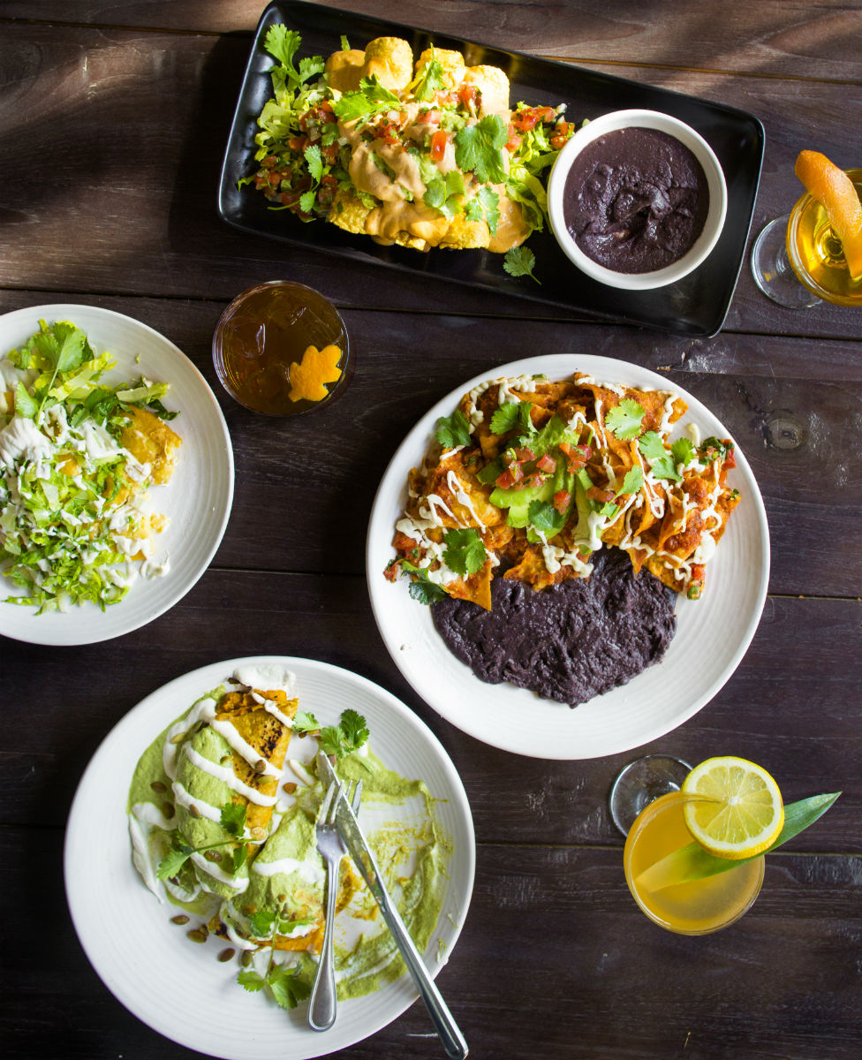
Monopoly & Monopolistic Competition · Profit Maximization
Price Searcher: Maximizing Profit
Price
P*
Profit
MC
ATC
ATC
MR
D
Q*
Output
Management 405 · Monopoly and Monopolistic Competition
10
Notes:
Gracias Madre is a plant-based Mexican restaurant in west-Hollywood.
https://www.graciasmadre.co/
To maximize profit, monopolist sets MC=MR — only difference with respect to perfect competition is that under perfect competition MR=P, but that is no longer the case for a monopolist.

Slide 11
Monopoly & Monopolistic Competition · Profit Maximization
Price Searcher: Minimizing Loss
Price
ATC
MC
P*
Loss
ATC
AVC
Contribution
AVC
D
MR
Q*
Output
Losses because P < ATC — but P ≥ AVC, so keep producing to cover fixed costs
Management 405 · Monopoly and Monopolistic Competition
11

Slide 12
Monopoly & Monopolistic Competition · Profit Maximization
Profit Maximization: Gracias Madre
The restaurant's demand
P = 60 − Q/10,000
The total cost
TC = 2,000 − 10Q + 0.20Q²
What are P* and Q*?
Problem Set 4 · #1
Group exercise break
Management 405 · Monopoly and Monopolistic Competition
12
Notes:
Total cost per day in a restaurant: 8,000 of which 3,000 food, 3,000 labor, 2,000 other
TC=2,000+60Q
Q=meal per day
At P=50 and 200 people, 10,000 revenue, profit=2,000

Slide 13
Monopoly & Monopolistic Competition · Profit Maximization
Gracias Madre: Solving for P* and Q*
1
Marginal revenue
TR = 60Q − Q²/10,000 MR = 60 − Q/5,000
2
Marginal cost
MC = −10 + 0.4Q
3
Set MR = MC
60 − Q/5,000 = −10 + 0.4Q
Q* = 175 units, P* = $59.98
Management 405 · Monopoly and Monopolistic Competition
13

Slide 14
Monopoly & Monopolistic Competition · Profit Maximization
Fixed Cost Does Not Impact Price
P
The fixed cost shifts ATC up. The firm would pay up to the Profit area for the right to produce.
P*
Once paid, the fixed cost does not change P* — set only by d and MC. It only lowers profit; here profit after TFC is zero.
ATC′
Profit
if TFC=0
MC = AVC = ATC
MR
d
Q*
Q
Management 405 · Monopoly and Monopolistic Competition
14

Slide 15
Monopoly & Monopolistic Competition · Profit Maximization
Buying a Liquor License
Gracias Madre is considering buying a liquor license
  What is the maximum amount it would be willing to pay for it?
If it buys the license, how does this affect the optimal price and quantity?
P = 60 − Q/10,000 TC = 2,000 − 10Q + 0.20Q²
Group exercise break
Management 405 · Monopoly and Monopolistic Competition
15

Slide 16
Monopoly & Monopolistic Competition · Profit Maximization
Solution: Buying a Liquor License
Compute profit at the optimum
TR = P*Q* = 59.98 × 175 = 10,496.5
TC = 2,000 − 10 × 175 + 0.2 × 175² = 6,375
Maximum willingness to pay = profit = $4,121.5
If the license shifts demand out (more customers), the restaurant
can pass part of the cost on and raise prices
Management 405 · Monopoly and Monopolistic Competition
16

Slide 17
Monopoly & Monopolistic Competition · Roadmap
Outline
1
Profit maximization for price searchers
Set MR = MC; markup and the Lerner index
2
Monopoly and welfare impact
How monopoly restricts output and reduces welfare
3
Government and market power
Antitrust, regulation, and market definition
4
Monopolistic competition
Free entry drives long-run profit to zero
Management 405 · Monopoly and Monopolistic Competition
17

Slide 18
Monopoly & Monopolistic Competition · Markup & Lerner Index
Markup Across Firms
Company | Markup
Alphabet | 0.55
Amazon.com | 0.33
American Airlines Group | 0.24
Apple | 0.33
AT&T | 0.35
Johnson & Johnson | 0.72
Microsoft | 0.56
Pfizer | 0.78
Tesla | 0.25
United Airlines | 0.21
Whole Foods Market | 0.19
P − MC
Markup =
P
Source: De Loecker et al. (2019)
Management 405 · Monopoly and Monopolistic Competition
18
Notes:
Note that markup refers to MC and not AVC

Slide 19
Monopoly & Monopolistic Competition · Markup & Lerner Index
The Lerner Index
P − MC
1
= −
P
E_{D}
Links a firm's markup to its demand elasticity
As demand becomes more elastic, the optimal markup falls
The more price-sensitive customers are, the less a firm can mark up
Holds only at the profit-maximizing point (P*, Q*)
Management 405 · Monopoly and Monopolistic Competition
19

Slide 20
Monopoly & Monopolistic Competition · Markup & Lerner Index
Profit Maximization and the Lerner Index
Marginal revenue links price, MR, and demand elasticity
Profit maximization sets MR = MC
Rearranging gives the Lerner index
1
MR = P(1 +
)
E_{D}
1
P(1 +
) = MC
E_{D}
P − MC
1
= −
P
E_{D}
Management 405 · Monopoly and Monopolistic Competition
20

Slide 21
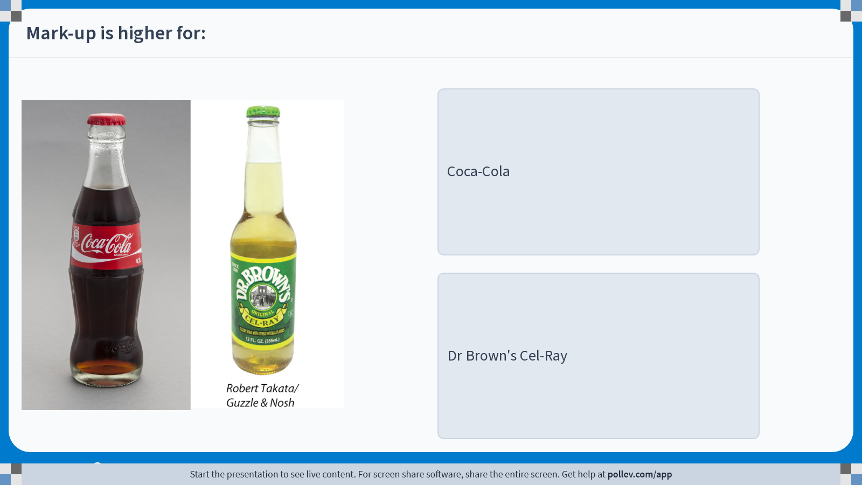
Monopoly & Monopolistic Competition · Markup & Lerner Index
Poll: Which Product Has the Higher Mark-up?
Management 405 · Monopoly and Monopolistic Competition
21
Notes:
Poll Title: Do not modify the notes in this section to avoid tampering with the Poll Everywhere activity.
More info at polleverywhere.com/support
Mark-up is higher for:
https://www.polleverywhere.com/multiple_choice_polls/Zmt5W14cKK6Xwqbv0nijt?display_state=instructions&activity_state=opened&state=opened&flow=Engagement&onscreen=persist

Slide 22
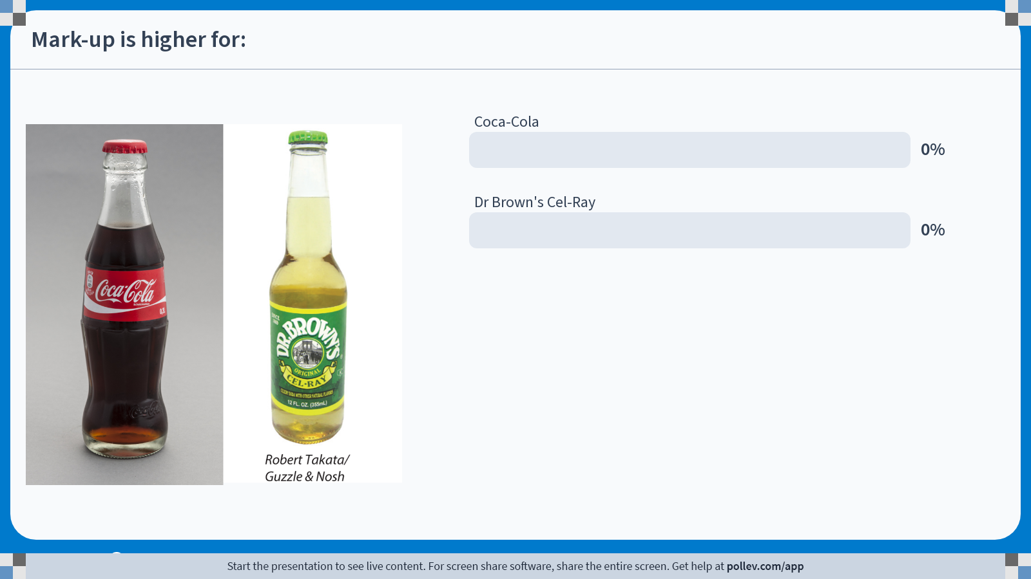
Monopoly & Monopolistic Competition · Markup & Lerner Index
Poll: Live Responses
Management 405 · Monopoly and Monopolistic Competition
22
Notes:
Poll Title: Do not modify the notes in this section to avoid tampering with the Poll Everywhere activity.
More info at polleverywhere.com/support
Mark-up is higher for:
https://www.polleverywhere.com/multiple_choice_polls/Zmt5W14cKK6Xwqbv0nijt?display_state=chart&activity_state=opened&state=opened&flow=Engagement&onscreen=persist

Slide 23
Monopoly & Monopolistic Competition · Markup & Lerner Index
Poll: Results
Management 405 · Monopoly and Monopolistic Competition
23
Notes:
Poll Title: Do not modify the notes in this section to avoid tampering with the Poll Everywhere activity.
More info at polleverywhere.com/support
Mark-up is higher for:
https://www.polleverywhere.com/multiple_choice_polls/Zmt5W14cKK6Xwqbv0nijt?display_state=chart&activity_state=closed&state=closed&flow=Engagement&onscreen=persist

Slide 24
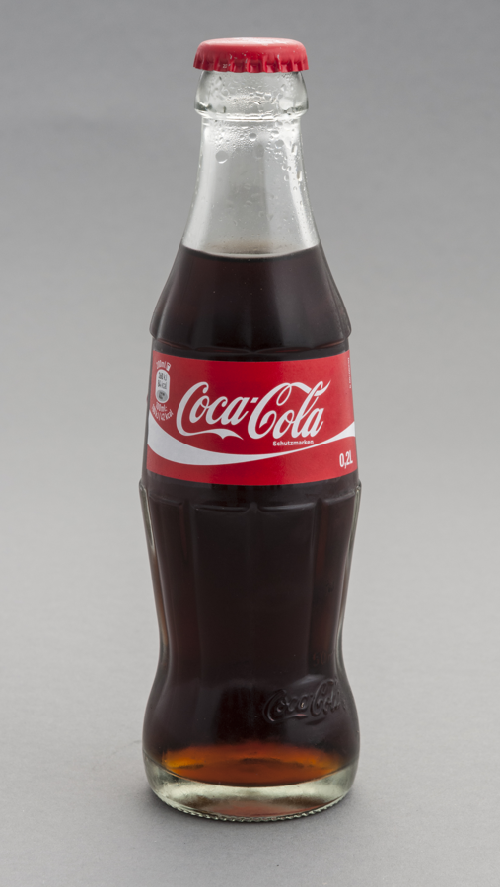
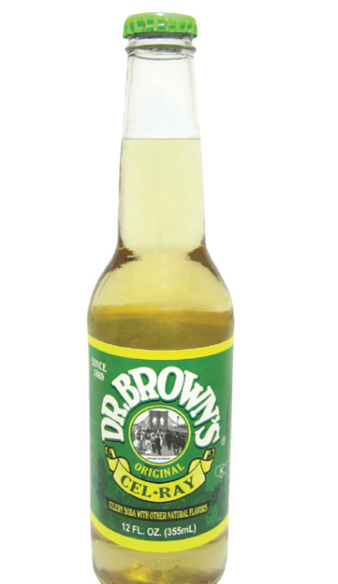
Monopoly & Monopolistic Competition · Markup & Lerner Index
Mark-up and Elasticity
Dr Brown's has the higher mark-up
Why? Its demand is less elastic
Coca-Cola
Dr Brown's Cel-Ray
1
1
Lerner (Coke) = −
= −
= 0.24
E_{D}
−4.1
1
1
Lerner (Cel-Ray) = −
= −
= 0.50
E_{D}
−2
Management 405 · Monopoly and Monopolistic Competition
24
Notes:
Prepare poll-ev Consider Coca-Cola and Dr Brown, which has the higher mark-up?
Elasticity is lower because of nich product

Slide 25
Monopoly & Monopolistic Competition · Markup & Lerner Index
Price Searcher: Take-aways
The decision rule is always the same
  Set MR = MC to find Q*
  Operate in the short run if P ≥ AVC
The key difference is a downward-sloping demand curve
  MR ≠ P — the price searcher sets P* > MR
Mark-up (price above marginal cost) depends on elasticity
Management 405 · Monopoly and Monopolistic Competition
25

